Slide 1







Weather Prediction
DEEPAK KUMAR BENIYA
PHY202302EF25

Slide 2


CONTENTS
1. Problem Statement.
2. Algorithm.
3. Flow chart.
4. Pseudo code.
5. Standards used.
6. Software Requirements.
7. Application Result

Slide 3

Problem Statement
A company wants develop Weather Predication program in C to predict the weather of current day by checking the data of previous week data.

Slide 4
Algorithm
START the program.
Enter Password.
Main function is called ,inside it data function is called .where last week's data are stored such like temperature, wind speed, humidity, days.
Then after the user will provide current day's temperature and it will be store in float data type.
The temperature which is provided by the user will be passed to the other function through pass by value, pointers are used here.
The current temperature will be checked with the last week's data if it matches the data, then it will provide the matched data to the user. such like Sunny, Rainy, Haze, Cloudy etc..

Slide 5
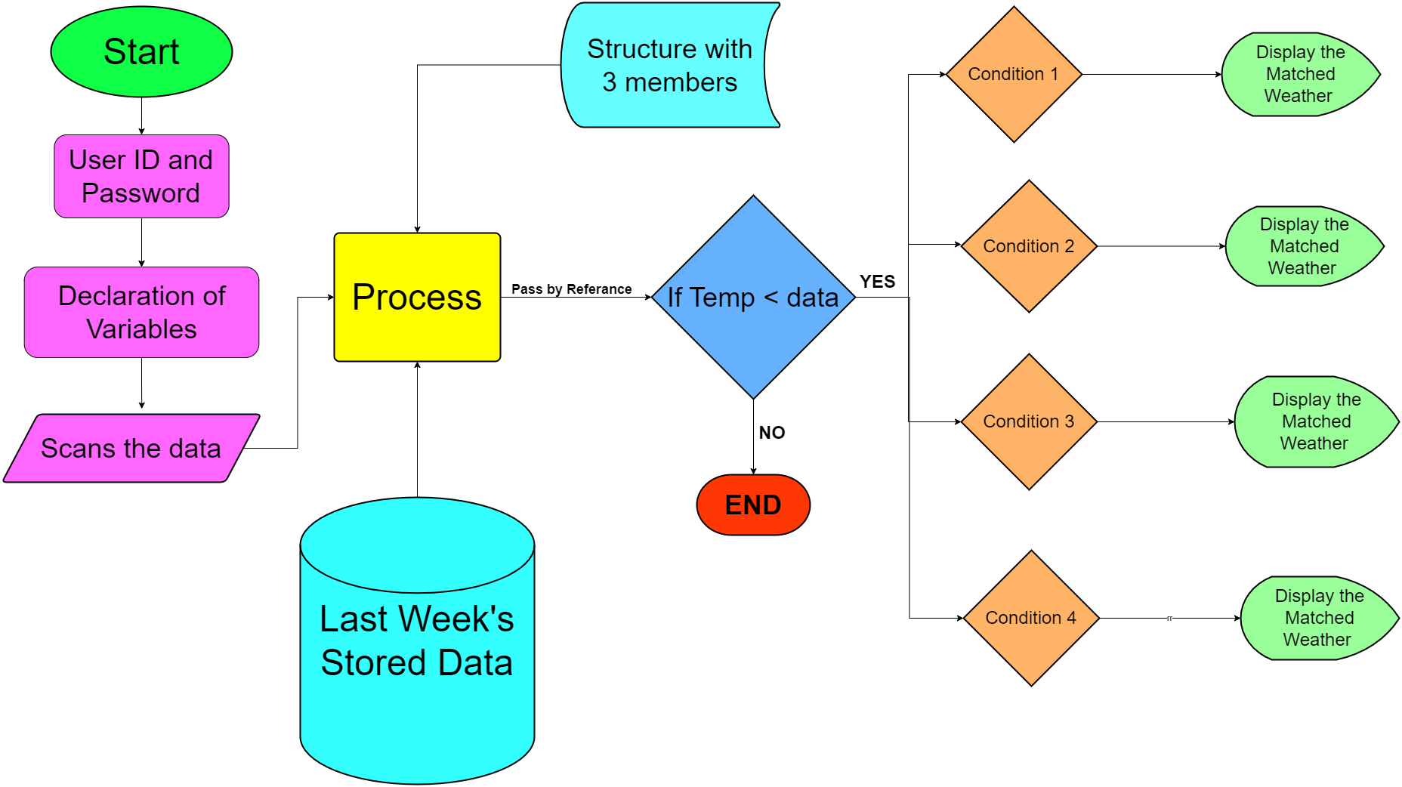
Apply page animations and
transitions to your Canva presentation to emphasize ideas and make them even more memorable.

Slide 6
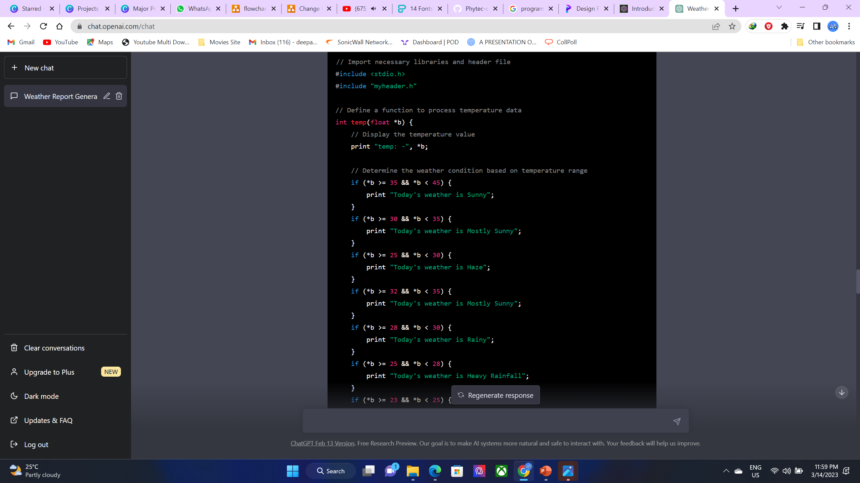
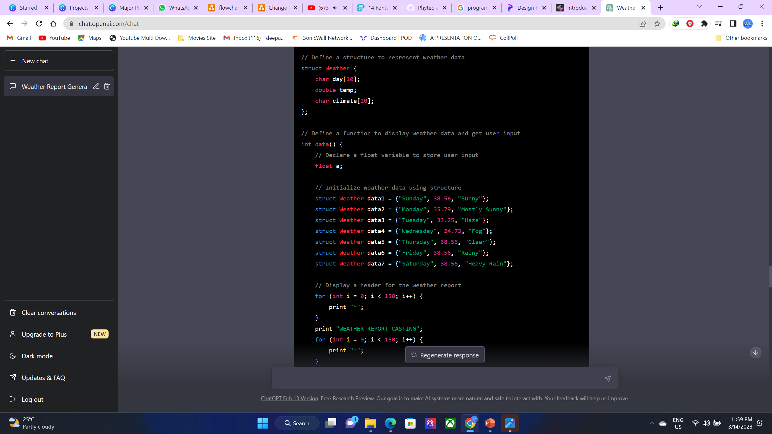

Slide 7

Standards used
Header file Implementation
The program is structured in a modular way with separate files for function prototypes and implementations, making it easy to modify and maintain.
Library Implementations
Makefile Implementation

Slide 8
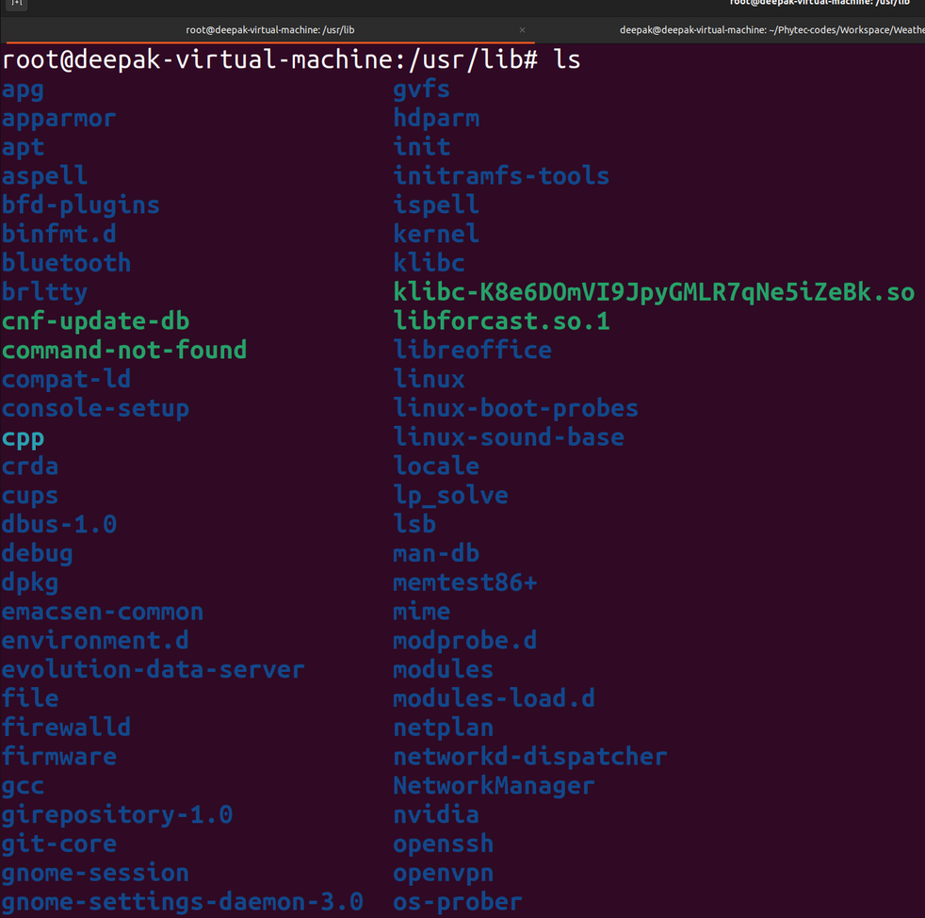
Topics Used in this Program
Data Types
Operators
Control Statement
Functions()
Pointers(call by reference)
Structures
Dynamic Library
Header file

Slide 9





Software Requirements

Slide 10
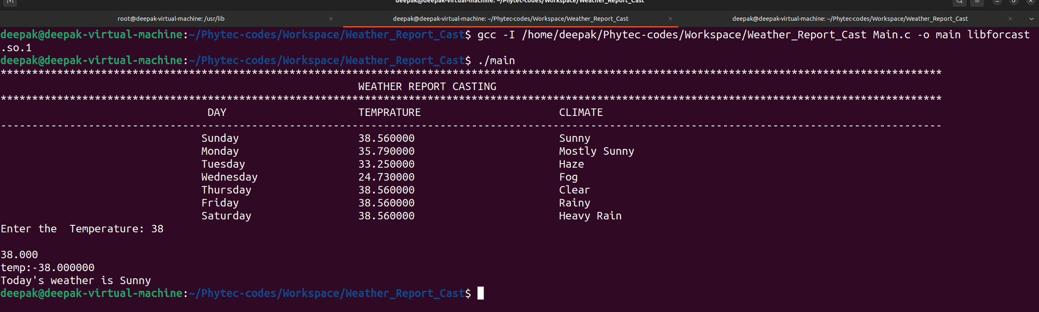
Result

Slide 11
Thank you!

